Slide 1

Buyer Processes
October 06, 2017

Slide 2

Source to Pay Project Objective
To deploy a single, global Source to Pay (PTP) capability enabling catalogs, contract compliance, centralized purchasing, exception management, invoice automation and control on rogue spend by leveraging standardized global process across all of Bose indirect procurement.
PROGRAM VISION
1
Provide a standardized and integrated SAP Ariba Source to Pay technology platform across all regions
2
Improving transactional process efficiency
Scalable Global Business Services capability in conjunction with GSM to improve throughput.
Make back office processes simpler and faster
Improve reporting capabilities
Key Benefits: Reliable processes; Reduced risk
Key Benefits: Improved processes
3
Improve Spend Visibility and Compliance
4
Improve user experience and supplier collaboration
Improved spend visibility and transparency throughout the Indirect Source to Pay process
Identify savings lever and improvement opportunities to drive cost efficiency
Make the integrated system more user friendly for requestors and users
Introduce mobile capabilities in P2P
Improve Supplier Collaboration leveraging network capability
Key Benefits: Improved spend visibility
Key Benefits: Increased user engagement with and buy-in to the SAP-Ariba system

Slide 3
Agenda
Section | Timing
Assemble & Welcome | 10 minutes
Chapter 1: Overview of Buyer Responsibilities | 30 minutes
Chapter 2: Manage Approval Queue | 30 minutes
Chapter 3: Review Catalogs and Contracts | 30 minutes
Course Summary | 20 minutes
TOTAL | 2:00 hours

Slide 4

Welcome!
Course Description: This course is designed to teach you the buyer processes. It will take you through the roles and responsibilities of a buyer and the buyer process after a requisition has been submitted
Course Duration: 2.0 hours
Pre-Requisites: Ariba Procure to Pay Overview and Basic Navigation training
Your classmates would like to learn about you. Tell us a bit about yourself:
Name
Location
Organization/alignment within Bose
Role/title

Slide 5




Housekeeping
Before we begin, let’s talk about expectations to make sure we all get the most out of this training course.
Use your breaks effectively and return to the class on time
Switch your cell phones to silent mode
Use your computers for exercises and assessments only, if needed
Listen actively, participate, and ask questions
Note the Restroom and Emergency Exit locations

Slide 6
Course Objectives
After completing this course, you will be able to:
Explain the buyer responsibilities
Manage approval queue
Review catalogs and contracts
Create collaborative requisition

Slide 7
Agenda
Section | Timing
Assemble & Welcome | 10 minutes
Chapter 1: Overview of Buyer Responsibilities | 30 minutes
Chapter 2: Manage Approval Queue | 30 minutes
Chapter 3: Review Catalogs and Contracts | 30 minutes
Course Summary | 20 minutes
TOTAL | 2:00 hours

Slide 8
Chapter Objectives
After completing this chapter, you will be able to:
Explain the buyer responsibilities
Differentiate between GSM and GBS buyer

Slide 9
Ariba Key Terms
Ariba Network (AN): Ariba Network is a cloud-based B2B marketplace where buyers and suppliers can find each other and do business within a single, networked platform.
Purchase Requisition (PR): A document that defines the need for goods and/or services. The PR must be created and approved to produce a Purchase Order. Any resubmission of a revised PO will be done through a revision and approval of the PR.
Purchase Order (PO): A commercial document and offer issued by a buyer to a seller, indicating types, quantities and agreed prices for goods or services. A PO will be created for every supplier in the PR. PO’s cannot be edited, only a 2nd version can be issued after the submission of an edited PR.
Invoice (IV): An itemized bill for goods sold or services provided. It must reflect the same amount as the PO and the Goods Receipt to be automatically processed for pay.
Goods Receipt (RC): A document issued to acknowledge the receipt of the items listed in it. It must be completed before the supplier can be paid.
Invoice Reconciliation (IR): If a three way match is not produced, this document allows the requester to understand the issue and reconcile the issue.
Preparer: If a user purchases goods or services on behalf of another user, they become the preparer for the requester. The requester is put at the front of the approval flow and both the preparer and requester can receive goods and reconcile invoices in relation to the Purchase Requisition created.

Slide 10
Buyer Responsibilities: GSM & GBS buyers
GSM (Global Supplier Management) is more of a strategic buyer
GSM has primary responsibility to govern indirect spend, maximize total value for funds spent and manage supplier risk
GSM will lead the process of new supplier approval, sourcing events, supplier contracts, supplier selection process, and the negotiation of price, terms and conditions prior to the development of a Contract and/or Purchase Order
Sole Source Supplier in which there is no viable option as determined by GSM.
Involved in Strategic Spend, defined as purchases of indirect goods and services with spend of ≥$50,000 USD (≥$25, 000 USD in China and India) or any time a Contract is required.
GBS (Global Business Services) is more of a tactical buyer
GBS may perform tactical buying on spend <$50,000 in addition to any extension of spend within an existing contract

Slide 11
Agenda
Section | Timing
Assemble & Welcome | 10 minutes
Chapter 1: Overview of Buyer Responsibilities | 30 minutes
Chapter 2: Manage Approval Queue | 30 minutes
Chapter 3: Review Catalogs and Contracts | 30 minutes
Course Summary | 20 minutes
TOTAL | 2:00 hours

Slide 12
Chapter Objectives
After completing this chapter, you will be able to:
Assign approvers
Enable reading notification email

Slide 13
Assign approvers
As a part of managing approvers, there will be Approval Queue Admin for GSM and GBS.
Based on the value of the Purchase Requisition, Ariba PTP system will automatically route it to either GSM or GBS Approval Queue Admin
The GBS/GSM Approval Queue Admin would route it to the appropriate buyer and assign him/her as an approver for the requisition

Slide 14
Reading notification email

Slide 15
Agenda
Section | Timing
Assemble & Welcome | 10 minutes
Chapter 1: Overview of Buyer responsibilities | 30 minutes
Chapter 2: Manage Approval Queue | 30 minutes
Chapter 3: Review Catalogs and Contracts | 30 minutes
Course Summary | 20 minutes
TOTAL | 2:00 hours

Slide 16
Chapter Objectives
After completing this chapter, you will be able to:
Identify repetitive purchase and candidates for catalog/contract
Add an item to contract
Add an item to catalog
Collaborative Requisitioning (2 bids ‘n’ buy)

Slide 17
Identify repetitive purchase and candidates for catalog/contract

Slide 18
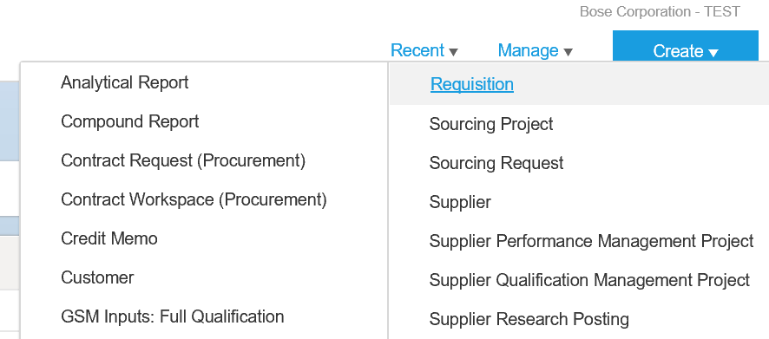
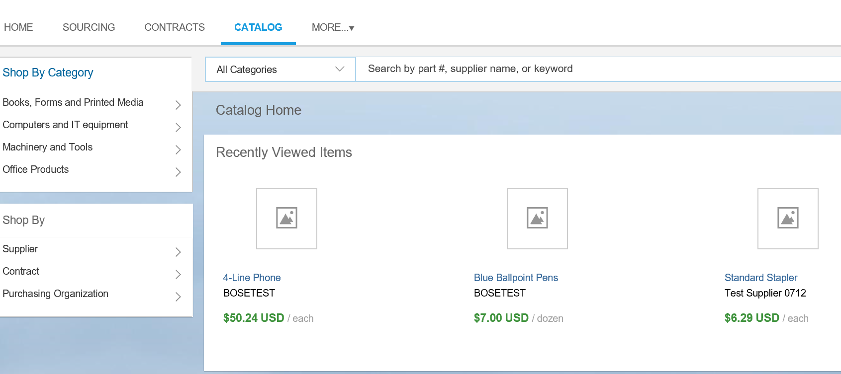
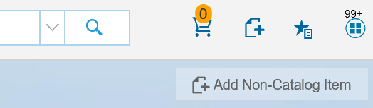
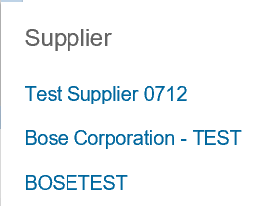
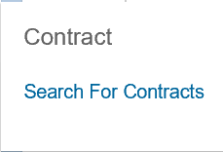
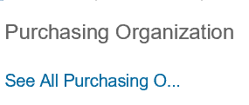
Collaborative Requisitioning (2 bids ‘n’ buy)
1
To create a requisition using a catalog, click Create > Requisition from the list.
2
On the Catalog screen, following items will be present (from L to R): Shopping Cart, Add non-Catalog item, View And Manage Favorites and Return to Dashboard icon.
3
You can also shop by Supplier, Contract, or Purchasing Organization.
4
Click Add Non-Catalog Item
1
2
4
3

Slide 19
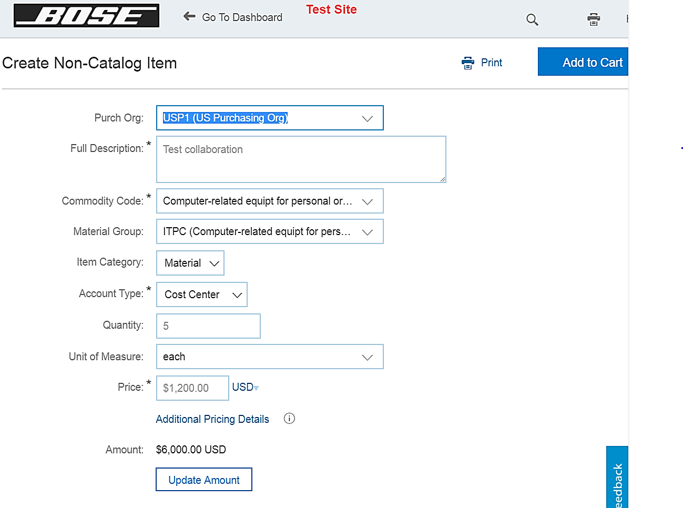
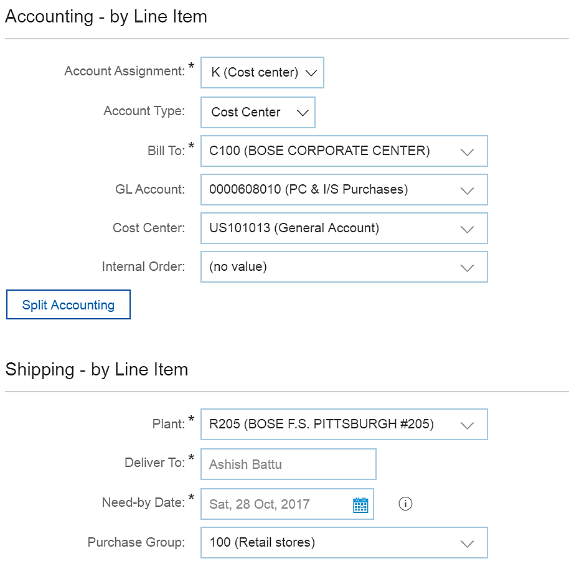
Collaborative Requisitioning (2 bids ‘n’ buy)
5
Enter or Validate the appropriate information in the fields: Full
Description, Material Group, Quantity and price.
6
Click Update Amount.
5
7
6
7
While updating the Accounting information for the line item,
ensure to validate or populate the fields:
Account Assignment
Bill-To
Cost Center

Slide 20
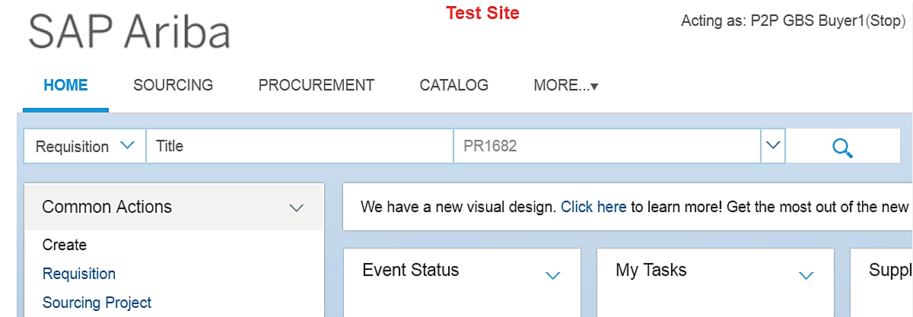
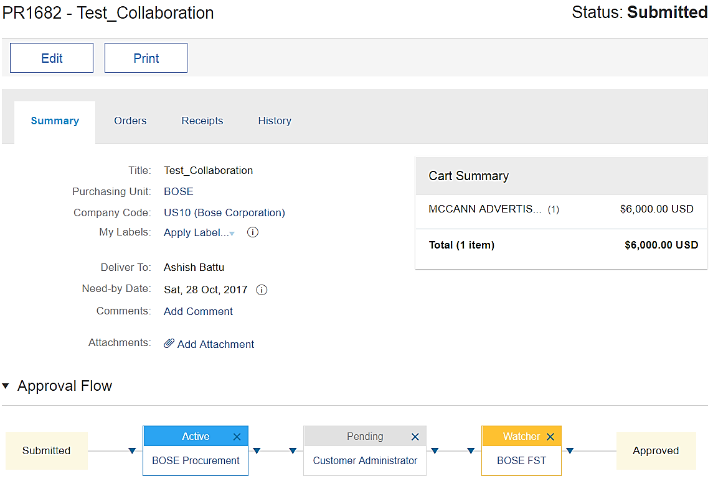
Collaborative Requisitioning (2 bids ‘n’ buy)
8
Enter the PR number in the search field.
8
10
9
On clicking on the approval flow, the list of approvers is displayed
10
Click Edit
9

Slide 21
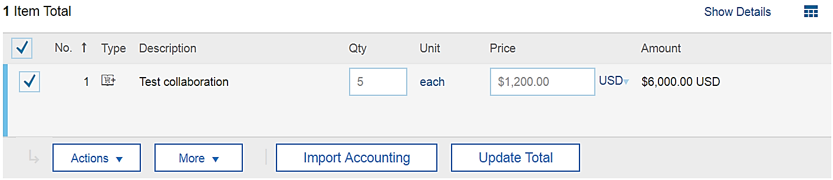
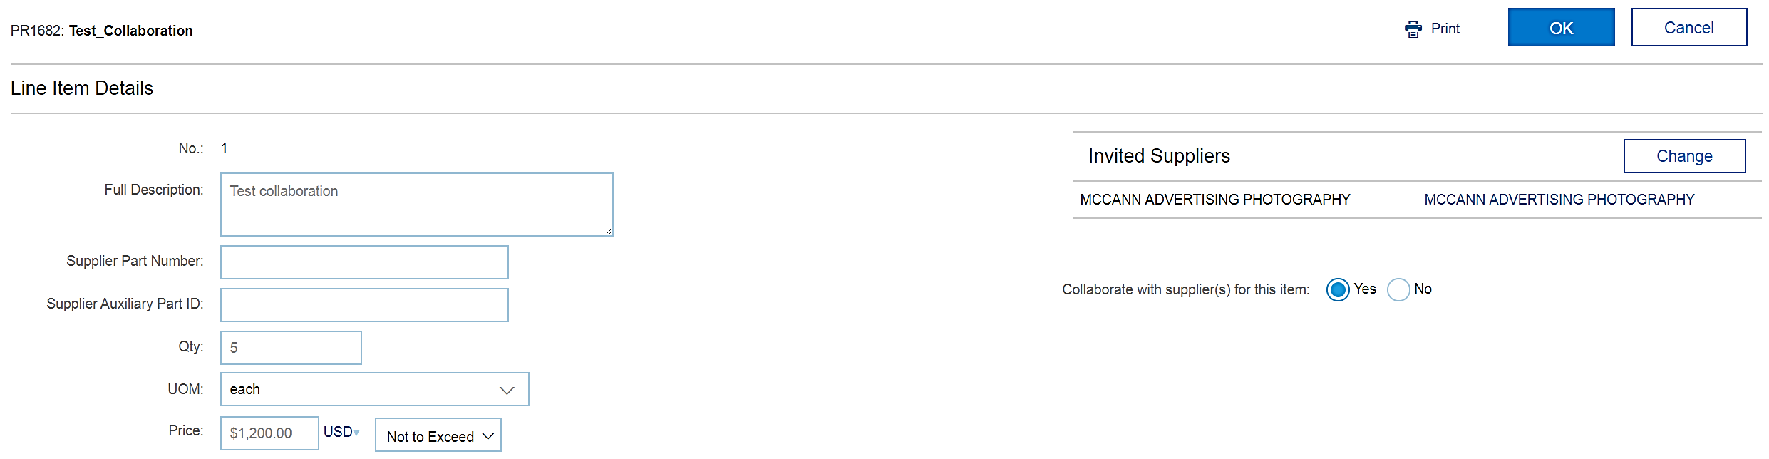
Collaborative Requisitioning (2 bids ‘n’ buy)
11
Click Actions and select Edit
12
Select Yes in the Collaborate with supplier field
11
Click Change to select new supplier or delete existing supplier
13
13
12

Slide 22
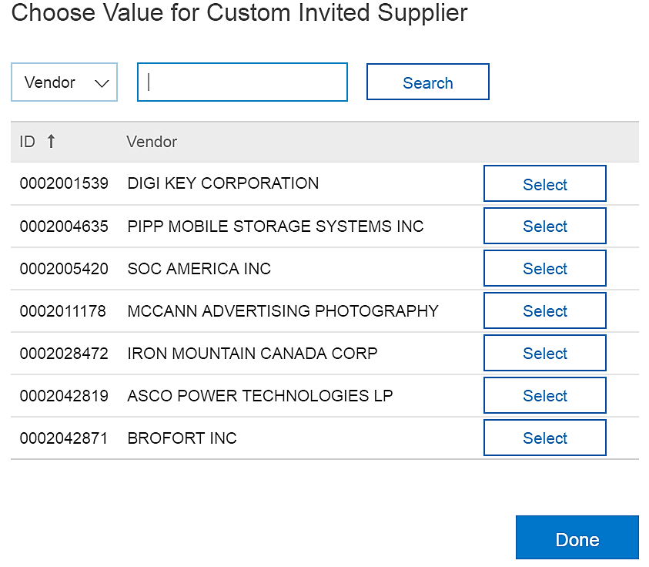
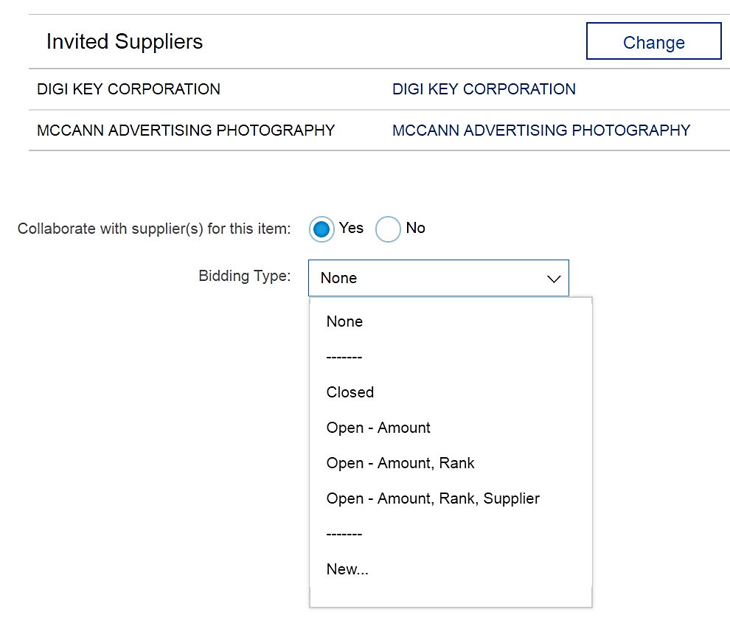
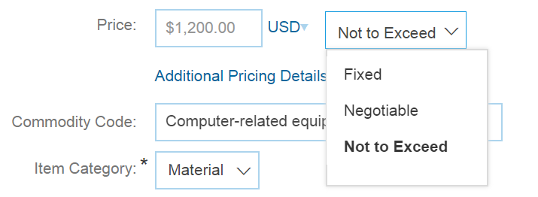
Collaborative Requisitioning (2 bids ‘n’ buy)
14
On Choose Value for Custom Invited Supplier, click Select button next to the Vendor of choice.
14
15
Click Done after selecting a supplier
16
Select the appropriate bidding type: Closed; Open-amount; Open-Amount, Rank; Open-Amount, Rank, Supplier
15
17
16
17
Price: Choose between Fixed; Negotiable; Not to exceed

Slide 23
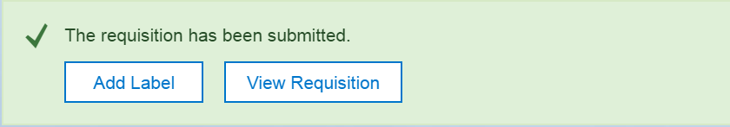
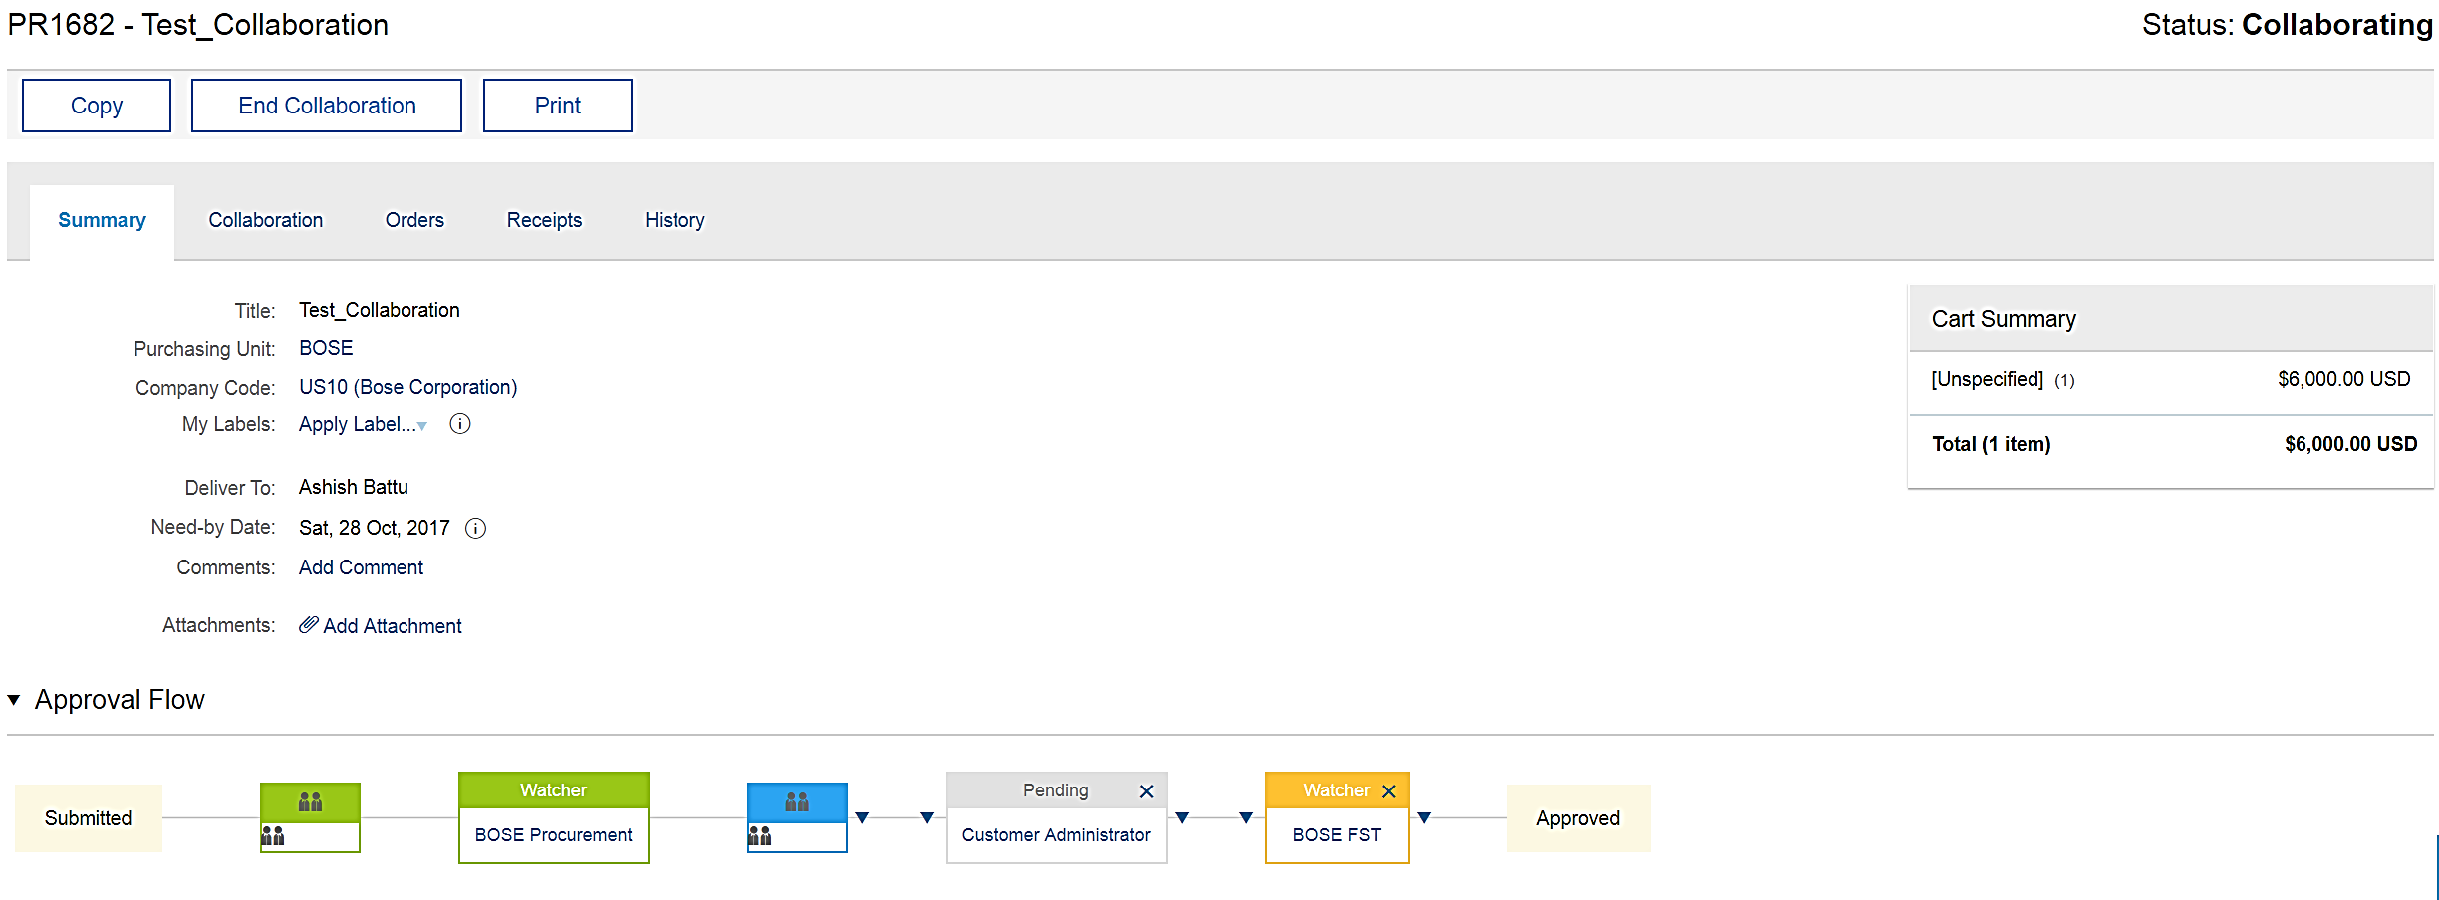
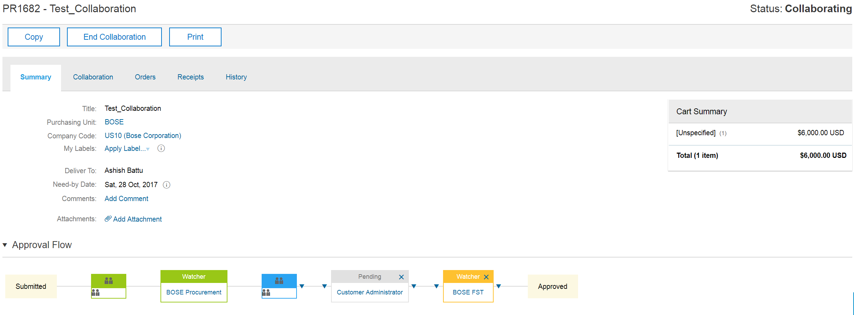
Collaborative Requisitioning (2 bids ‘n’ buy)
18
Click View Requisition to check for the PR status
and approval flow
18
19
On clicking on the approval flow, the updated list of
approvers is displayed
20
Status changes to Collaborating
20
19

Slide 24
Key Changes to Procurement (1 of 3)
Current Process
Future Process
Non-functioning SRM catalogs
Variety of catalogs (Punch-out, Hosted and Line Item level Contract based Catalog items)
Purchase
Requisitions
Shopping cart from SRM manually converted to PO in ECC
Requestor creates a requisition, which auto converts to a PO upon approval
Document based UI approval
Buyer involvement in the shopping cart creation
Requisition Approval via UI or Email or Mobile App
Catalog Requisition (no Buyer intervention)
Non-Catalog Requisition (Buyer to source or review)
Requisition
Approvals & FP1 Policy Approvals
Delegates provide approval up to USD 50,000
CMER - Abbreviated Approval process
New fixed approval levels at USD 10K, 25K, 50K AND 100K
Removal of Delegates from Approval flow
No CMER - Abbreviated Approval process

Slide 25
Key Changes to Procurement (2 of 3)
Current Process
Future Process
Any limit or framework orders are created as Purchase Orders with Item Category B
Created as Service PO/Blanket PO/Contract
Manage Purchase Orders
Manual contract release order
Contracts will be auto referenced for release orders enabled by electronic contract and compliance for PO
POs are either not created or created after the Invoice is received
PO to be created upfront in Ariba PTP and not after the fact
No PO no Pay policy (> USD 2500)
Non-Catalog requisitions up to USD 50,000 will be sourced by GBS Buyers (between USD 2500 to USD 50,000 will need 2 bids and buy)
Non-Catalog requisitions above USD 50,000 will be sourced by GSM Buyers
No Receipt for Purchase Order value up to USD 5000
An auto receipt will be created based on the invoice for PO value up to USD 500
Manual receiving required for PO value over USD 500
Receiving Goods & Services

Slide 26
Key Changes to Procurement (3 of 3)
Current Process
Future Process
Receiving is a cumbersome process
Low Receipt compliance
Limit Orders may have receipts
An email notification contains a link to receipt screen for the respective PO
No receipt required against Blanket Purchase Order Contract
Receiving Goods & Services
Transaction code based reporting
Streamlined reporting with drill down capability
User friendly and one stop shop for PTP document reporting
Reporting

Slide 27
Benefits of these Changes
Ariba PTP helps automate the Procure to Pay process.
Data Entry
Exceptions
Discounts
Visibility
Allows requestors to search, view and buy products using intuitive navigation features
Simplified and automated 3-way match process
Electronic Catalogs and contracts help in avoiding cases of incorrect pricing, inaccurate descriptions, and wrong part numbers
GBS will not spend lot of time on errors due to product information mis-match between PO and invoice
Reduces processing time leads to discount opportunities
Correct pricing information results in getting paid quicker and more accurately
Availability of Ariba Search mechanism and pre-packaged reports to view the status of all Ariba documents
Ariba Public Reports can be created by using simple drag and drop mechanism
Supplier has visibility to ALL Ariba Network (AN) invoices and payments

Slide 28
Procure to Pay Roles
Role
View catalogs, and Complete Purchase Requisition form
Create Purchase Req. (PR), Search item in Catalog, Update and submit PR
Create PO in Ariba P2P, transmit to AN, and mange PO changes
Receive PO, create Order Confirmation, create ASN, Flip PO to Invoice
Acknowledge invoices
Manage and coordinate invoice exceptions in Ariba P2P
Requestor
Buyer
FP1 Approver
A/P
Supplier

Slide 29

Types of Buying Channels
Buying Channel | Example Categories | Criteria/Guideline
Catalog Purchase Order | Office products, furniture, MRO | Published items (Punch-out or Internal) Repeated purchases Established contracts with negotiated pricing including dynamic updates based on volume discounts
Demand-driven direct, indirect (stock) and capital | Integrated circuits, memory, polymers | Direct and capital goods based on accurate forecasts; MRP Prices are stable; SKUs are defined Excluding exceptions
Preferred supplier purchase | Marketing retainers, press relations, paid media | Non-catalog /frequent purchases Established pricing guidelines and rate cards (MSA/SOW) Preferred suppliers utilized
Non-catalog Purchase Order | Ad hoc goods and services, test equipment, rentals | Medium-complexity and / or medium-value purchases Need limited sourcing / procurement oversight to align to category strategies (e.g., spot sourcing in P2P) and to negotiate the terms of the purchase $2,500-$50,000 requires at least 2 bids (‘N’ bids and a buy) Below $2,500 does not require multiple bids
3rd Party sourcing |  | Tail spends management Need sourcing / procurement outsourcer oversight to negotiate the terms of the purchase for control and visibility
Invoice against contract | Facilities services, legal services | Leveraged for complex services Established contract pricing Invoice required due to supplier specifications No goods receipt or service confirmation required for payment
Contract Purchase Order | Consulting services | Leveraged for complex services with milestone based deliverables PO required for confirmation of receipt (3 way match) Buyer-touchless PO generations, only fiscal approval
Invoice only | Utilities, real estate | Regular low-value transactions with approved suppliers Does not require procurement oversight
Payment with no invoice | Charitable contributions, royalties, credit card payments | Low-value transactions and suppliers that are not managed by procurement Check requests are used as last resort for managing exceptions to defined Buying Channels
1
2
3
4
Greater cost savings and spends management
5
6a
6b
7
8

Slide 30
Rationale for Buying Channels
To standardize procurement processes, increase spend visibility and improve ease of transaction.
Definition
Framework
A step-by-step channel strategy of the functional activities that support the fulfillment of specific spend categories
Buying Channels answer the following questions for end users:
How should certain types of spends (capital, direct or indirect) be purchased?
What is it satisfactory for a purchase to be completed with invoice only?
Which types of spends should be purchased through a catalog?
How complex are the steps for certain types of purchases?
What technology enables each step of the source to pay continuum?
Buying
Channels
Realize significant benefits to the organization by leveraging leading practice spend management solutions, particularly a purchasing solution to improve usability, compliance and controls to contracted pricing
Mapping spends categories to Buying Channels leads to greater contract realization
Streamlining significantly increases contract compliance while reducing labor costs
The maximum financial and operation benefit will be realized if the process is simple for field with minimal change, yet it provides levers to reduce spend and bring visibility to the Source to Pay process
Eliminating sub-optimal processes and improving remaining options results in a simpler more efficient process
Clearly defined Buying Channels yield greater data visibility which supports continuous improvement
Rationale for Buying Channels
Benefits

Slide 31
Buying Channel: Non-Catalog with Purchase Order
Sourcing
Requisition
Pay
Identify Need
Source
Contract
Create Requisition
Identify Supplier
Approval
PO Process
Receipt / Order Confirmation
Invoice Receipt
Reconcile Invoice
Payment
Level of Effort / Complexity
Planned / Forecasted
Strategically sourced
MSA
Catalog
Pre-selected preferred supplier
Fiscal
Auto
release
OC - Auto via supplier network
Electronic via network
Auto reconcile /
auto reject
Payment run
Business Requirement
Buyer sourced
SOW
Non-catalog
free form request
Preferred supplier
Buyer
Manual
GR or SC – Manual in Ariba
Email
Workflow to exception handler
P-Card
Unplanned / Ad hoc
Spot buy
Rate card
Demand driven goods
Existing non-preferred supplier
Sourcing
3rd party platform
3rd party platform
Paper
Manual Process
Check request
No sourcing
Contract with pricing terms
3rd party platform
New supplier
Other approval
No PO
T&E
Key Elements
Spend Categories in Future State
Below $2,500 does not require multiple bids
$2,500-$50,000 requires at least 2 bids before buy
Leverage preferred supplier when possible to streamline downstream S2P activities
PO processing, order confirmations and possibly invoicing would be manual when preferred supplier not leveraged (if the supplier is not on the AN)
Possibly higher number of invoice exceptions
Process path for new suppliers
Sponsorships
New Program Tooling and Fixtures
New Program - Unclassified
New Program Prototype Parts
Industrial Equipment and Machinery
Equipment Rental
Employee Benefits
Unclassified
Meetings
Test & Measurement Equipment
Hotels
Low Complexity
Medium Complexity
High Complexity
Applicable
Not-applicable

Slide 32
Types of Purchase Requisitions
Purchase requisitions can be created using the following options:
Requisition with Catalog / Contract items (Touchless)
Create Requisition and get approval
Auto convert to Purchase Order and transmit to supplier
Process Receipt
Verify Invoice against PO and Receipt
Process Payment
Identify Need
Requisition with Non-Catalog / Free text item description (Touch)
Create Requisition
Buyer edits item by selecting supplier (2 bids & buy), get approval
Auto convert to Purchase Order and transmit to supplier
Process Receipt
Verify Invoice against PO and Receipt
Process Payment
Buyer involvement in the Procure to Pay process

Slide 33
Global FP-1 Approval Matrix and Ariba Workflow
The FP1 approval policy has been updated to standardize procurement approval processes, increase spend visibility and improve ease of transaction.
Business Approval by Cost Assignment Type
Internal Order | Cost Center & Asset
President | President
EVP (direct report to President) | EVP (direct report to President)
VP, Executive GM, CIO | VP, Executive GM, CIO
Director or Plant Manager | Director or Plant Manager
Cost Center Manager AND Internal Order Project Mgr | Cost Center Manager 5
Cost Center Manager AND Internal Order Project Mgr | Cost Center Manager 4
Internal Order Project Mgr | Cost Center Manager 3
Internal Order Project Mgr | Cost Center Manager 2
Internal Order Project Mgr | Cost Center Manager 1
Level | Levels (in USD) | Business Approval | Finance Approval
9 | $5,000,000+ | President
8 | $2,000,001-5,000,000 | EVP (direct report to President) | CFO
7 | $500,001- 2,000,000 | VP, Executive GM, CIO | Direct Report to CFO
6 | $250,001-500,000 | Director or Plant Manager | Finance Director or Division Controller
5 | $100,001-250,000 | Project Mgr (if Internal Order) AND Cost Center Manager 5 | Controller
4 | $50,001-100,000 | Project Mgr (if Internal Order) AND Cost Center Manager 4 | Controller
3 | *$25,001 - 50,000 | **Project Mgr (if Internal Order) AND/OR Cost Center Manager 3 | Controller
2 | *$10,001 - 25,000 | **Project Mgr (if Internal Order) AND/OR Cost Center Manager 2 | Controller
1 | *$0 - 10,000 | **Project Mgr (if Internal Order) AND/OR Cost Center Manager 1 | Analyst delegate OR Optional
* - New Approval levels Added
** - Project Manager Approval added for Internal Orders

Slide 34
Invoice Reconciliation – Exception Scenarios (2 of 3)
The various exceptions scenarios that can occur for the Buyer User group and the required actions that must be performed to resolve them are as follows:
Description | User Group that would be receiving email | Available Approval Actions | Actual Actions to be performed | Reasons for not performing certain action
PO Price Variance | Buyer | Accept invoice price | DO NOT ACCEPT INVOICE PRICE - If this price is the true price of the purchase. Change the PO with the new price and the system would release the exception | -
 |  | Accept expected price | If the PO price is accurate then select this function | -
 |  | Manual Match | DO NOT USE THIS FUNCTION | This function is for manually matching any invoices with another PO
 |  | Defer to someone else | Use this function only if the person who is proposed to perform the action is aware of what actions need to be taken | This function is delegating the decision/action to some other person.
PO Catalog Price Variance | Buyer | Accept expected price | If the PO price is accurate then select this function | -
 |  | Manual Match | DO NOT USE THIS FUNCTION | This function is for manually matching any invoices with another PO
 |  | Defer to someone else | Use this function only if the person who is proposed to perform the action is aware of what actions need to be taken | This function is delegating the decision/action to some other person.
Shipping Variance | Buyer | Accept invoice amount | If the shipping amount is accurate then select this function | -
 |  | Accept expected amount | If the PO amount is accurate then select this function | -
 |  | Manual Match | DO NOT USE THIS FUNCTION | This function is for manually matching any invoices with another PO
 |  | Defer to someone else | Use this function only if the person who is proposed to perform the action is aware of what actions need to be taken | This function is delegating the decision/action to some other person.

Slide 35
Invoice Reconciliation – Exception Scenarios (3 of 3)
The various exceptions scenarios that can occur for the Buyer User group and the required actions that must be performed to resolve them are as follows:
Description | User Group that would be receiving email | Available Approval Actions | Actual Actions to be performed | Reasons for not performing certain action
Item Unmatched | Buyer | Accept invoice price | DO NOT ACCEPT INVOICE PRICE - If this price is the true price of the purchase, add the missing line and the system would release the exception | -
 |  | Accept expected price | If the PO price is accurate then select this function | -
 |  | Manual Match | DO NOT USE THIS FUNCTION | This function is for manually matching any invoices with another PO
 |  | Defer to someone else | Use this function only if the person who is proposed to perform the action is aware of what actions need to be taken | This function is delegating the decision/action to some other person.
PO Quantity Variance | Buyer | Accept invoice quantity | DO NOT USE THIS FUNCTION - Change the PO quantity in this case and the exception would be resolved automatically | -
 |  | Accept expected quantity | DO NOT USE THIS FUNCTION - If the invoice quantity is more than the actual Goods Receipt and PO quantity, then this can be used | -
 |  | Manual Match | DO NOT USE THIS FUNCTION | This function is for manually matching any invoices with another PO
 |  | Defer to someone else | Use this function only if the person who is proposed to perform the action is aware of what actions need to be taken | This function is delegating the decision/action to some other person.
Invoice Currency Mismatch | Buyer | Approve Rejection | This would approve the rejection that Ariba has performed | -
 |  | Cancel Rejection | To be validated | -

Slide 36
Summary of Key Design Decisions
Purchase Requisitions (1 of 2)
ID | Key Design Decision | People | Process | Technology | Decisions | Degree of Impact | Role
3 | Services spend within Ariba – Requisition & Receiving (for second bullet) | Y | Y | Y | Creating Service requisition Service PO will require Services Entry sheet as the confirmation in PTP. | High | Buyer, Requisitioner, FP1 Approver
4 | Purchase requisition – Discounts – Contract Compliance | Y | Y |  | Add discount to the total cost of the purchase requisition | Medium | Requisitioner, Buyer
5 | Ship-to & Bill-to - Ordering | Y | Y |  | Default ship to from the user's profile, but requestor be able to change the ship-to if need be. | Medium | Requisitioner, Buyer
7 | Need by date - Requisition |  | Y | Y | Need by date should be defaulted as Today's date on the requisition which can be changed by user For Catalog items - date should get picked up based on the lead time | Low | Requisitioner, Buyer
8 | AN and Non-AN supplier collaboration | Y | Y | Y | Require Tactical sourcing – 2 bids n buy NO change on non-AN supplier | High | Buyer

Slide 37
Summary of Key Design Decisions
Purchase Requisitions (2 of 2)
ID | Key Design Decision | People | Process | Technology | Decisions | Degree of Impact | Role
10 | Accounting | Y | Y |  | Accounting objects like Assets, Internal order, Cost center can be changed but G/L accounts cannot be changed by user / buyer on the requisition. | Medium | Requisitioner, Buyer
11 | Account assignment categories U and X | Y |  |  | There will not be any account assignment categories U and X used in any of the purchase requisition created, Only account assignment categories be used – Assets(A), Cost center(K) and Internal Order(F) | Medium | Requisitioner & Buyer
12 | Approvals Escalation | Y | Y | Y | 3rd day warning and 5th day escalation to the supervisor (Excluding CEO) | High | FP1 Approver, Buyer, Requisitioner
13 | Requisition approvals | Y | Y | Y | FP1 approvals will be applicable for all the requisitions as per policy | Medium | Requisitioner, Buyer
14 | Splitting | Y | Y | Y | Split PO for different Supplier, Catalog/Non-Catalog, . Do not split for different Ship-To (Decision pending) P-card (excluding APAC and Europe) | Medium | Requisitioner, Buyer

Slide 38
Summary of Key Design Decisions
Purchase Orders
ID | Key Design Decision | People | Process | Technology | Decisions | Degree of Impact | Role
1 | Release Order | Y |  | Y | If Release Orders are created based on contracts, the contract number to be referenced on the PO | Medium | Requesters, Buyers
3 | Ship-to address at line and header | Y | Y |  | Ship-to will be at header if same for all line items, else in the line item | Medium | Suppliers, Requesters, Buyer
4 | Order confirmation and ASN | Y | Y | Y | Order confirmation and Ship Notices are optional features, will be sent from AN to Ariba P2P but not to ECC | High | Requester, Buyer
5 | Notifications | Y | Y | Y | Summary email notification of the PO(s) sent at the end of day to Requestor / Preparer | Medium | Suppliers, Requesters, Buyer

Slide 39
Summary of Key Design Decisions
Receiving (1 of 2)
ID | Key Design Decision | People | Process | Technology | Decisions | Degree of Impact | Role
1 | Receiving - Central (ECC) and Desktop (Ariba) | Y | Y | Y | Desktop receiving in Ariba P2P and Central receiving in ECC will done. Receipts will be synced between the systems | High | Requester, Buyer
2 | No approval on receipts | Y | Y | Y | There will not be approvals on receipts over 500 USD | Medium | Buyer, Requester
3 | Receipts segregation to be done in Ariba | Y | Y | Y | Receipts created in ECC and Ariba are not to be segregated | Low | Buyer, Requester
4 | Receipts imported, manual receipt not allowed | Y | Y | Y | Central receipts imported from ECC to Ariba for PO, subsequent receipts in Ariba for those PO(s) can originate from ECC only. | Medium | Requester, Buyer
5 | Real time in ECC | Y | Y | Y | Job will be scheduled every 15 mins to synced the receipts | Low | Requester, Buyer
6 | Auto receiving <=$500 | Y | Y | Y | Auto receiving of the services or GR will happen for the PO value less than equal to $500 when the invoice is received | Medium | Requester, Buyer
7 | Partial receipts | Y |  | Y | Partial receipts allowed for any PO in Ariba | Low | Requester, Buyer
8 | ERS not in Ariba | Y |  |  | ERS will not be enabled in Ariba | Low | Requester, Buyer

Slide 40
Summary of Key Design Decisions
Receiving (2 of 2)
ID | Key Design Decision | People | Process | Technology | Decisions | Degree of Impact | Role
9 | Over delivery tolerance | Y |  |  | New over delivery tolerance of 10 percent | Low | Requester, Buyer
10 | Goods returns or negative receipts - No rejection scenario | Y | Y | Y | Goods return and Rejection of goods handled with negative receipts in Ariba | High | Requester, Buyer, Supplier

Slide 41
Summary of Key Design Decisions
Services
ID | Key Design Decision | People | Process | Technology | Decisions | Degree of Impact | Role
1 | Service PO | Y | Y | Y | Ariba's Service PO functionality will be used to represent demand for Services. Enables the use of Service Entry Sheets and sub-lines. | Medium | Requester, Buyer
2 | Auto SES below <=$500 | Y | Y | Y | Automatic Service entry sheet will be created in Ariba P2P when the invoice submitted for the PO value less than or equal to $500 | Medium | Requester, Buyer, Supplier
3 | BPO/Contract for Services | Y | Y |  | Ariba to represent demand for Services using a no-release Contract or BPO | Medium | Requester, Buyer, Supplier
4 | Maximum limit | Y | Y | Y | Overall limits on the service PO to be hidden, when the service order is sent to a supplier enabled on the Ariba Network | Low | Requester, Buyer

Slide 42
Summary of Key Design Decisions
Payment/Remittance
ID | Key Design Decision | People | Process | Technology | Decisions | Degree of Impact | Role
1 | Payment remittance information | Y | Y | Y | Payment remittance information will be sent from the ECC Payment system to Ariba (AN or P2P) | High | Supplier, A/P, Buyer, Requester
2 | Remittance cancellation | Y | Y | Y | Remittance cancellation will be sent to Ariba AN and P2P | High | Supplier, A/P, Buyer, Requester
3 | Payment consolidation | Y | Y | Y | Remittance will be consolidated for multiple invoices if the payment system creates one payment document referencing multiple invoices | High | Supplier, A/P, Buyer, Requester
4 | Payment net amount on the remittance | Y | Y | Y | Vendor can be paid less than the amount on the invoice approved in Ariba from the payment system where - - Tax accrual / Withholding - Discounts - Offsetting vendor credits This will reflect in the Payment transaction document in Ariba sent from ECC | Medium | Supplier, A/P, Buyer, Requester

Slide 43
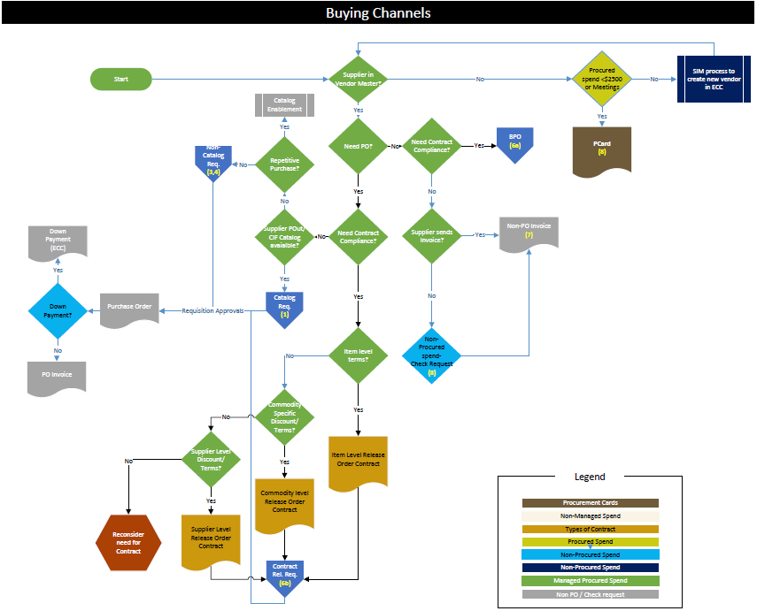
Buying Channel Decision Tree

Slide 44
Buying Channel Decision Tree

Slide 45
Buying channel Decision Tree
Need PO?
Supplier in Vendor Master
Need PO?
Need PO?
Need PO?
Need PO?
Need PO?
Need PO?
Need PO?
Need PO?
Need PO?
Need PO?

